Slide 1


VISIONEXTRACT: ISOLATION FROM IMAGES USING IMAGE SEGMENTATION

Slide 2

PRESENTATION
AGENDA
Overview of Milestone 1
Overview of Milestone 2
Milestone 3
Model Improvements
Inference on new images
Results (U-net)
Proposed Solution
System Architecture
Web Application

Slide 3

MILESTONE 1
TASKS TO BE COMPLETED
Week 1: Project Initialization and Dataset Acquisition
• Define project objectives and expected results.
• Acquire and inspect an appropriate image segmentation dataset with subject mask annotations.
• Explore dataset structure and view example images and masks.
Week 2: Data Preprocessing and Validation
• Develop a preprocessing pipeline (resize, normalization, augmentation).
• Ensure correct alignment of images and annotated masks.
• Convert multi-class masks (if present) into binary masks identifying only the main subject.

Slide 4


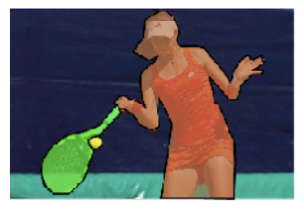
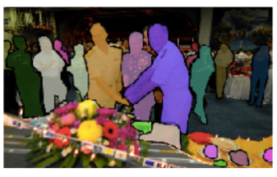
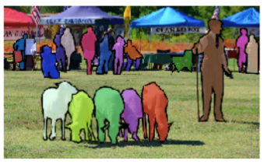
DATASET
EXPLORATION
• The project uses the COCO 2017 segmentation dataset containing over 200,000 labeled images with object segmentation annotations.
• The dataset includes 80 object classes such as person, car, bicycle, animals, and common everyday objects.
• It consists of image folders and JSON annotation files storing class labels, image metadata, and polygon segmentation coordinates.
• Dataset structure and class distribution were analyzed by inspecting annotation categories and folder organization.
• Sample images, class labels, and corresponding masks were visualized to study segmentation quality.
• Image–annotation alignment was verified to ensure accurate mask generation.

Slide 5

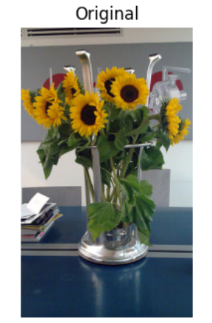
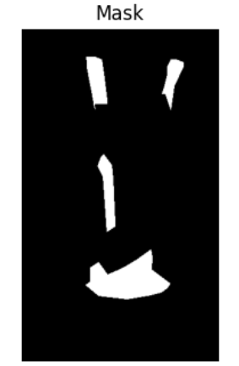
AUTOMATED
SUBJECT ISOLATION
• Automatically detects the main subject in an image.
• Extracts the subject while removing the background.
• Sets all non-subject pixels to black.
• Produces a clean cutout image of the original subject.
• Supports image editing and media processing workflows.

Slide 6
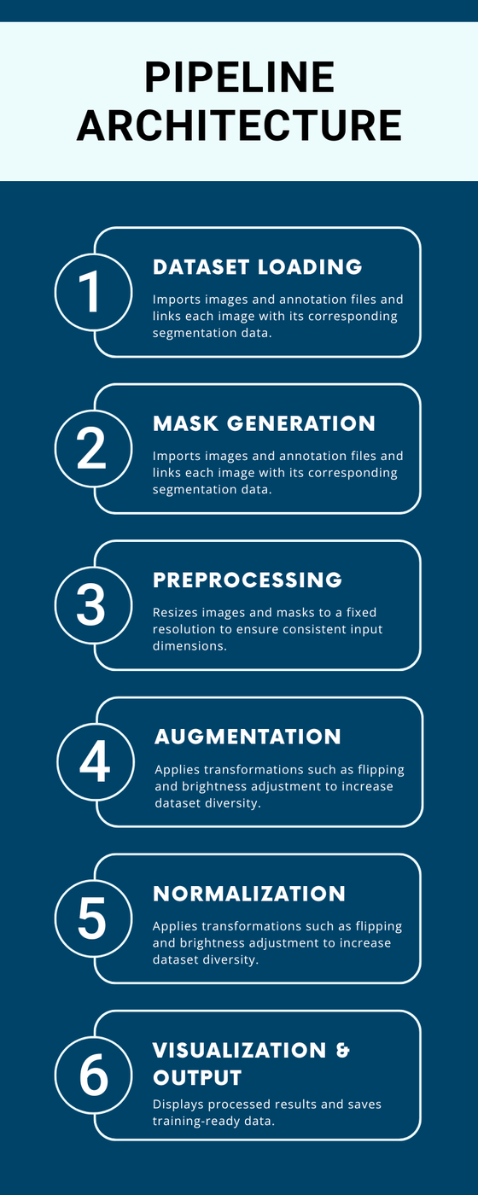
PIPELINE
ARCHITECTURE
• Dataset Loading Module: Imports images and annotation files and links each image with its corresponding segmentation data.
• Mask Generation Module: Converts polygon annotations into pixel-level segmentation masks for subject extraction.
• Preprocessing Module: Resizes images and masks to a fixed resolution to ensure consistent input dimensions.
• Augmentation Module: Applies transformations such as flipping and brightness adjustment to increase dataset diversity.
• Normalization Module: Scales image pixel values and converts masks into binary format.
• Visualization & Output Module: Displays processed results and saves training-ready data for future model development.

Slide 7

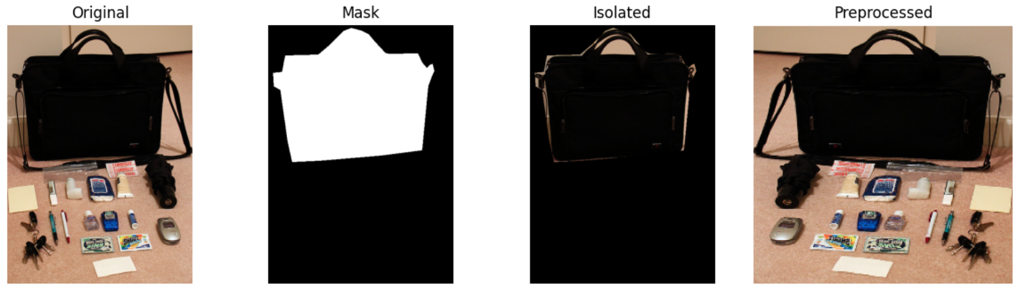
RESULTS
SUBJECT ISOLATION AND PREPROCESSING
• Successfully generated segmentation masks from dataset annotations.
• Verified correct alignment between original images and masks.
• Applied preprocessing pipeline including resizing, normalization, and augmentation.
• Demonstrated subject isolation using binary masks.

Slide 8
MILESTONE 2
TASKS TO BE COMPLETED
Week 3: Initial Model Training
• Implement the initial image segmentation network.
• Train the model on the processed data and monitor basic metrics.
• Visualize early predictions to verify subject extraction is proceeding as expected.
Week 4: Predictions and Fine-tuning
• Generate predictions on a validation set.
• Examine output images and compare with ground-truth subject masks.
• Adjust model hyperparameters and perform data augmentation to improve results.

Slide 9
WEEK 3
U-NET MODEL ARCHITECTURE
Encoder–Decoder based architecture
Encoder: Extracts high-level contextual features through convolution and pooling
Decoder: Restores spatial resolution using up-sampling layers
Skip Connections: Transfer fine-grained features from encoder to decoder
Output: Binary segmentation mask highlighting subject regions

Slide 10


WEEK 3
DATA PREPARATION
Dataset Used: COCO 2017 – val2017
Total Images: 5000
Data Split:
Training: 70% (3500 images)
Validation: 15% (750 images)
Testing: 15% (750 images)
Random shuffling ensured unbiased data distribution
Ground-truth masks used for supervised learning

Slide 11

WEEK 3
MODEL TRAINING DETAILS
Loss Function: Binary Cross-Entropy (BCE)
Optimizer: Adam Optimizer
Learning Rate: 0.0001
Batch Size: 8
Training performed over multiple epochs
Validation loss monitored to track learning progress and avoid overfitting

Slide 12
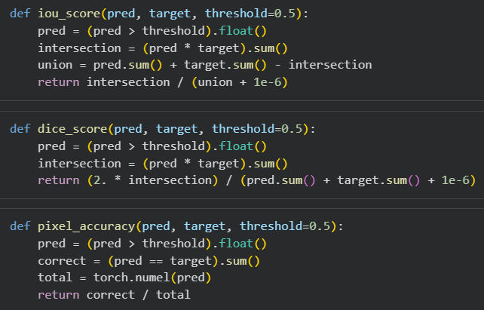
WEEK 4
EVALUATION METRICS USED
Intersection over Union (IoU): Measures overlap between predicted and ground-truth masks
Dice Coefficient: Evaluates similarity between two segmentation outputs
Pixel-wise Accuracy: Computes proportion of correctly classified pixels
These metrics collectively assess segmentation quality and reliability.

Slide 13


WEEK 4
VALIDATION RESULTS ANALYSIS
Predicted masks visually compared with ground-truth masks
Observed accurate subject extraction with minor boundary imperfections
Detected noise in complex background regions
Insights from validation guided fine-tuning decisions

Slide 14
WEEK 4
FINE-TUNING STRATEGY
Introduced combined loss function (BCE + Dice Loss)
Reduced learning rate for more stable weight updates
Increased training epochs to refine feature learning
Focused on improving boundary precision and mask smoothness

Slide 15
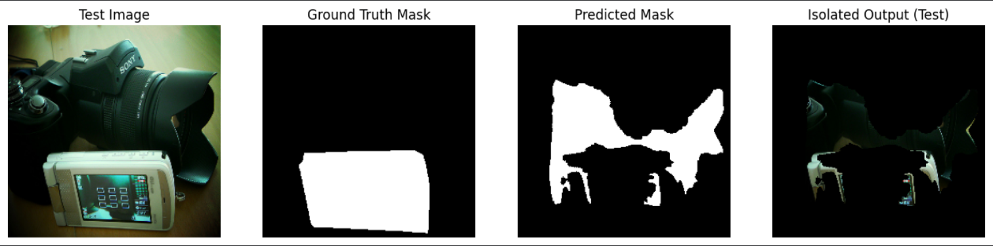
WEEK 4
TEST SET EVALUATION
Evaluated model on unseen test dataset (15%)
Computed IoU, Dice, and Pixel Accuracy
Confirmed strong generalization capability
Verified absence of overfitting

Slide 16
MILESTONE 3
TASKS TO BE COMPLETED
Week 5: Improve Data and Experiment with Architectures
• Refine preprocessing, explore further augmentations or post-processing for cleaner masks.
• Explore additional model architectures or training strategies for improved subject separation.
• Compare variant performance and document findings.
Week 6: Inference
• Deploy the trained model for inference on new, unseen images.
• Automate the pipeline: for uploaded input, generate and save the subject isolated output image.
• Test with images outside the original dataset to check robustness.

Slide 17
MILESTONE 3
MODEL IMPROVEMENTS
To enhance segmentation performance, several improvements were introduced.
Additional augmentation techniques were applied to increase dataset diversity.
A combined loss function using Binary Cross Entropy and Dice Loss was implemented to improve segmentation accuracy, especially along object boundaries.
These improvements helped the model learn better representations of subject regions and produce more accurate masks.

Slide 18
MILESTONE 3
MODEL IMPROVEMENTS
Predicted segmentation masks may contain noise or small artifacts that reduce output quality.
To improve mask quality, morphological post-processing operations were applied.
These operations include:
Morphological closing
Morphological opening
These techniques remove small noise regions and smooth the mask boundaries, resulting in cleaner subject extraction.

Slide 19
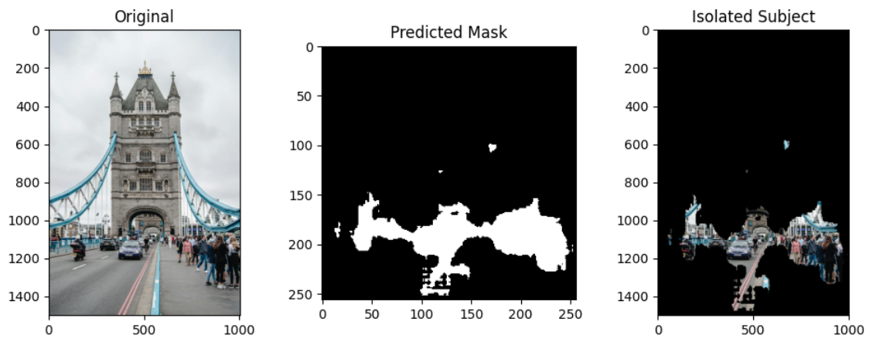
MILESTONE 3
INFERENCE ON NEW IMAGES
The trained model was deployed for inference on new images.
The inference pipeline works as follows:
User uploads a new image.
The image is resized and normalized.
The trained segmentation model predicts a mask.
The mask identifies subject regions in the image.
Background pixels are removed to generate the final isolated subject image.
This demonstrates the real-world application of the developed system.

Slide 20
MILESTONE 3
RESULTS
The system successfully performs automatic subject isolation.
The results include:
Input image
Predicted segmentation mask
Final isolated subject image
Visual results demonstrate that the model can effectively separate subjects from complex backgrounds.

Slide 21
MILESTONE 3
PROPOSED SOLUTION
The project proposes a hybrid segmentation approach combining two powerful models:
Mask R-CNN for object detection and instance segmentation
DeepLabV3 for semantic segmentation and refinement
Workflow:
Detect all objects in the image
Select the most relevant object (main subject)
Refine segmentation using DeepLabV3
Apply post-processing to improve mask quality
This approach overcomes limitations of individual models and produces better results.

Slide 22
MILESTONE 3
SYSTEM ARCHITECTURE
Detailed Flow Explanation:
Input image is provided by the user
Mask R-CNN processes the image:
Detects multiple objects
Generates individual masks
The system selects the main subject based on confidence score
DeepLabV3 refines the segmentation:
Improves edges
Removes noise
Morphological operations clean the mask
Final output:
Isolated subject image

Slide 23
MILESTONE 3
MASK R-CNN
Mask R-CNN is an advanced deep learning model for instance segmentation
It extends Faster R-CNN by adding a mask prediction branch
Outputs:
Bounding boxes
Class labels
Pixel-level masks for each object
Key Features:
Detects multiple objects in a single image
Provides precise object localization
Limitation:
Does not refine edges perfectly

Slide 24
MILESTONE 3
DEEPLABV3
DeepLabV3 is a semantic segmentation model
It classifies each pixel into a specific class
Uses Atrous Convolution to capture multi-scale context
Advantages:
Produces smooth and accurate segmentation maps
Handles complex scenes effectively
Pixel-level masks for each object
Limitation:
Cannot distinguish between multiple objects of the same class

Slide 25
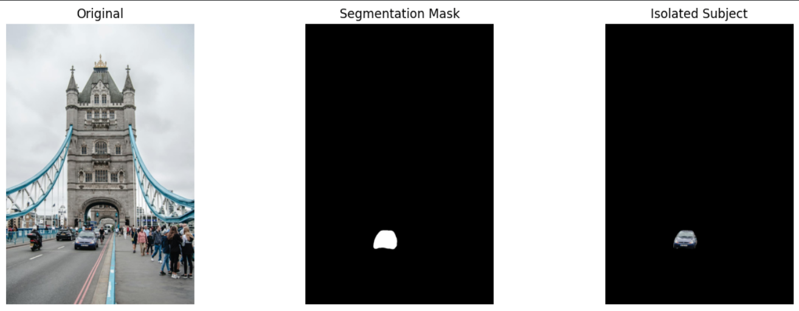
MILESTONE 3
RESULTS

Slide 26
MILESTONE 3
RESULTS

Slide 27
MILESTONE 3
WEB APPLICATION
Developed an interactive interface using Gradio
Features:
Upload image
Process image using AI model
Display output instantly
Download result
Benefits:
User-friendly
Real-time interaction
Easy deployment

Slide 28
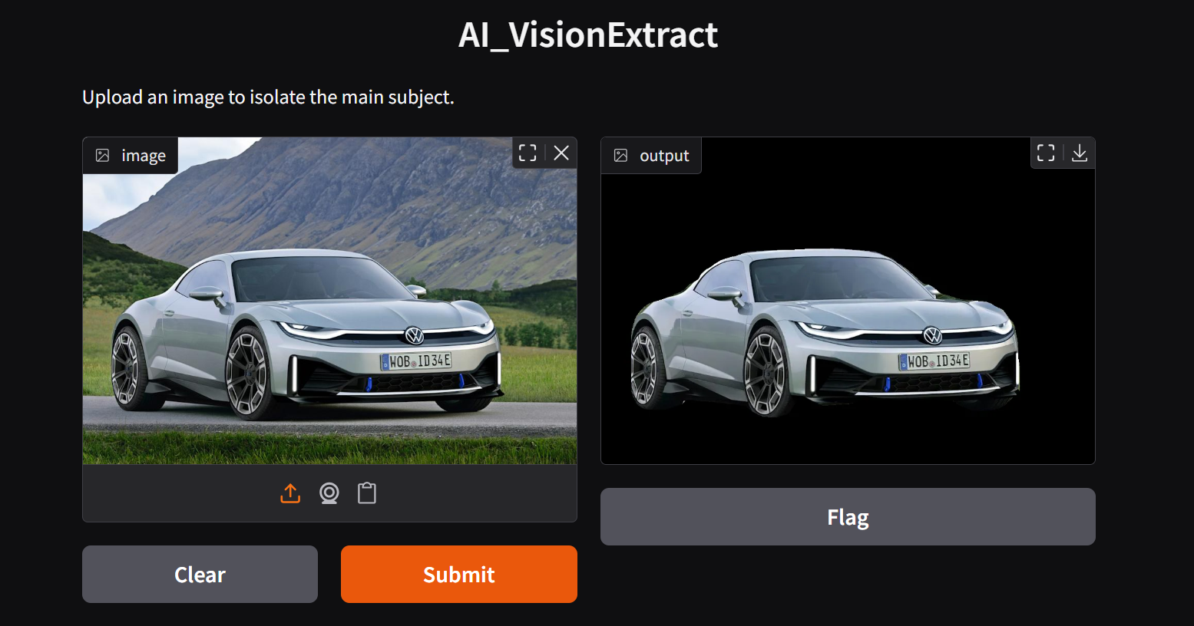
MILESTONE 3
WEB APPLICATION

Slide 29




THANK YOU

